Slide 1
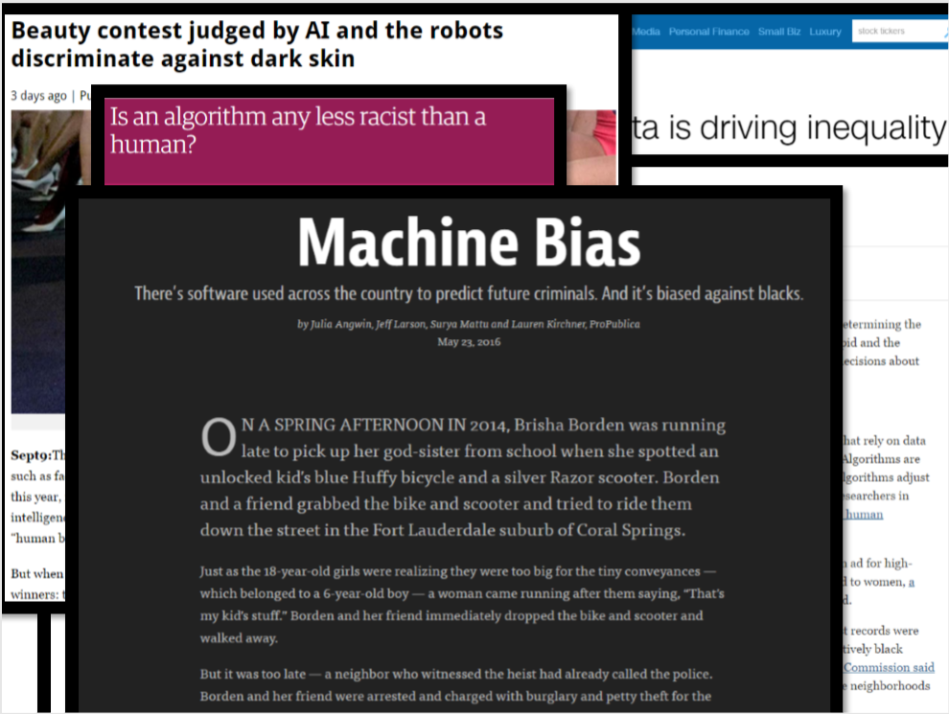
How fair can we be?
Team Mangalyaan
Dhaval Bhanderi, Rutu Gandhi
CSCI 8360: Data Science Practicum

Slide 2

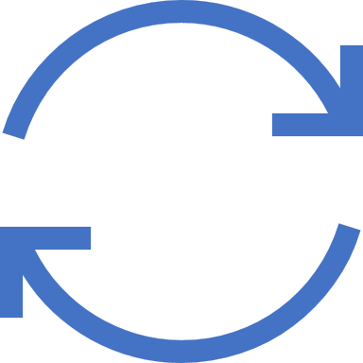
Agenda
Introduction
Example
What is Fairness?
Why it is hard?
Approach
Algorithm
Results
Conclusion
Recommendations

Slide 3

Introduction
AI affects our lives in many ways
Widespread algorithms with many small interactions
Recommendations, search, advertisement etc...
Specialized algorithms with many small interactions
Criminal justice, medicine, finance etc...
At this level of impact, algorithms can have unintended consequences.
But only low classification is not enough here, we need fairness
Notes:
General algorithms and socially sensitive

Slide 4
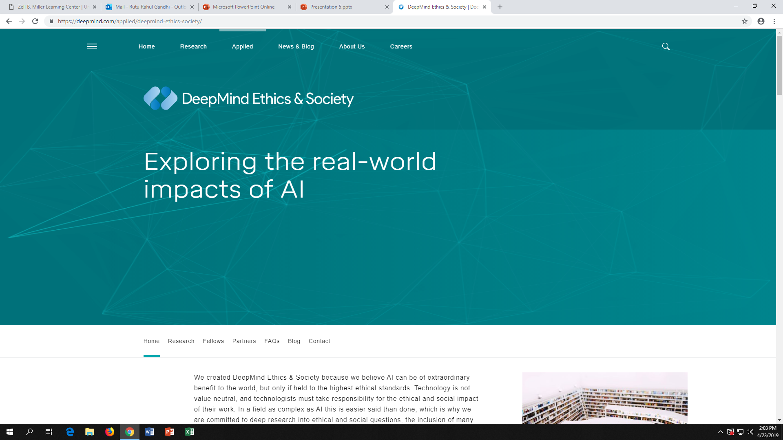
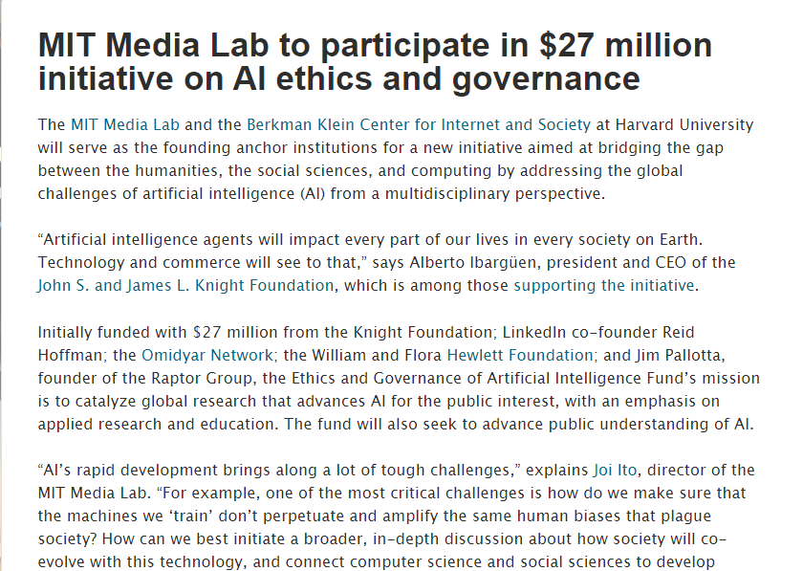

Slide 5
Example - COMPAS
Fairness is morally and legally motivated
Takes many forms
Criminal justice: recidivism algorithm(COMPAS)
Predicting if a defendant should receive bail
Unbalanced false positive rates: more likely to wrongly deny a black person bail
 | White | Black
Wrongly labeled as High-Risk | 23.5% | 44.9%
Wrongly labeled as Low-Risk | 47.7% | 28.0%
ProPublica Analysis of COMPAS Algorithm
https://www.propublica.org/article/machine-bias-risk-assessments-in-criminal-sentencing
Notes:
Compass: gives likelihood of a defendant commiting crime in future.

Slide 6

Example – Word Embeddings
Bias found word embeddings
Examined word embeddings (word2vec) trained on Google News
Vector arithmetic: analogies like,
Paris – France = London – England = Delhi – India
But, also found,
Man – Woman = Programmer – Homemaker = Surgeon – Nurse
The good news: word embeddings learn so well!!
And bad news: sometimes too well
And, our chatbots should be less biased than we are..!!

Slide 7
Definitions: Group Fairness
So, let's say we have our classifier, but how do we know if it's fair?
One metric is demographic parity – requiring that the same percentage of A and B receive loans
What if 80% of A is likely to repay, but only 60% of B is?
Then demographic parity is too strong
Could require equal positive/negative rates
When we make an error, the direction of that error is equally likely for both groups
"Treat different group equally"
P(loan|no repay, A) = P(loan|no repay, B)
P(no loan|would repay, A) = P(no loan|would repay, B)

Slide 8
Definitions: Individual Fairness
Unfortunately, the statistical definitions are not meaningful to individuals: because they are constraints only over averages taken over large populations.
They promise nothing about how an individual person will be treated.
"Treat similar examples similarly"

Slide 9
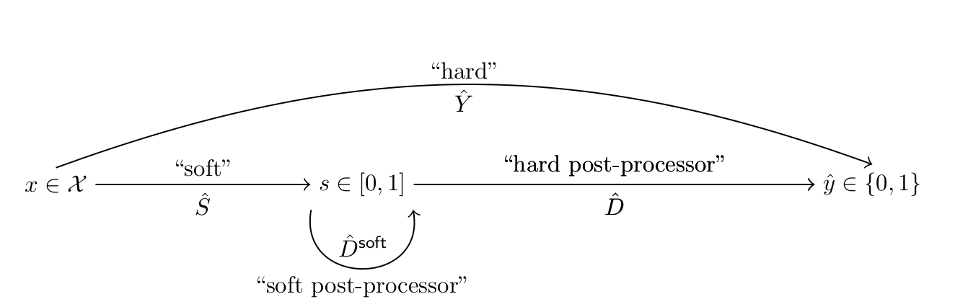
Approach
Discussed by:
Carnetti & Cohen, 2019
Under what conditions can we post-process a calibrated soft classifier’s outputs so that the resulting hard classifier equates a subset of {PPV, NPV, FNR, FPR} across a set of protected groups? How can we balance these conflicting goals?
Notes:
Machine bias is mostly studied by theoretical computer scientists and economists

Slide 10
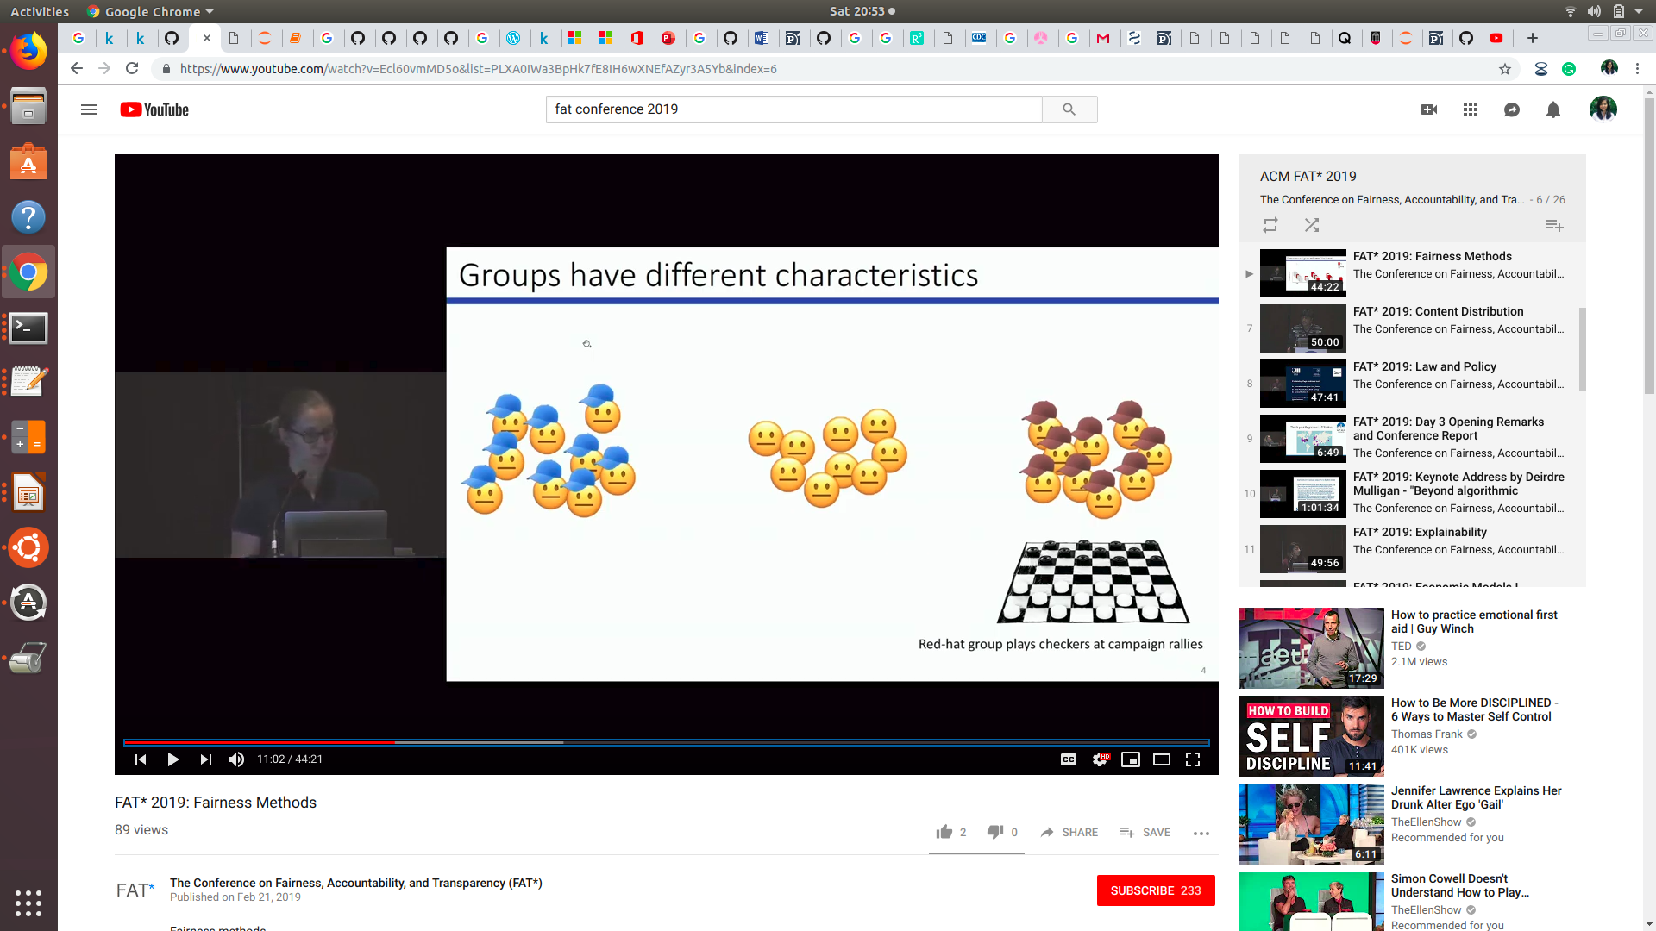
Hypothetical hateful content blocker including hateful imagery
Notes:
Imagine 3 political groups. Red hat are into checkers. Lots of their uploaded images contain checker boards.
Unrelatedly a hate group starts using a checkered flag as their symbol.
We want to ban all images containing cf.. Banning system not perfect. Some checkered flags are gonna get through the filter and will be posted anyway. Some others will be incorectly marked and banned.
Banning system works well for blue hat but causes problems in the red hat images, they think there is some political bias

Slide 11
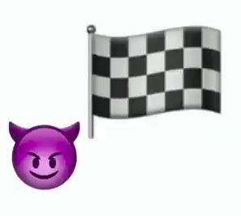
Checkered flag becomes hate symbol, now banned

Slide 12
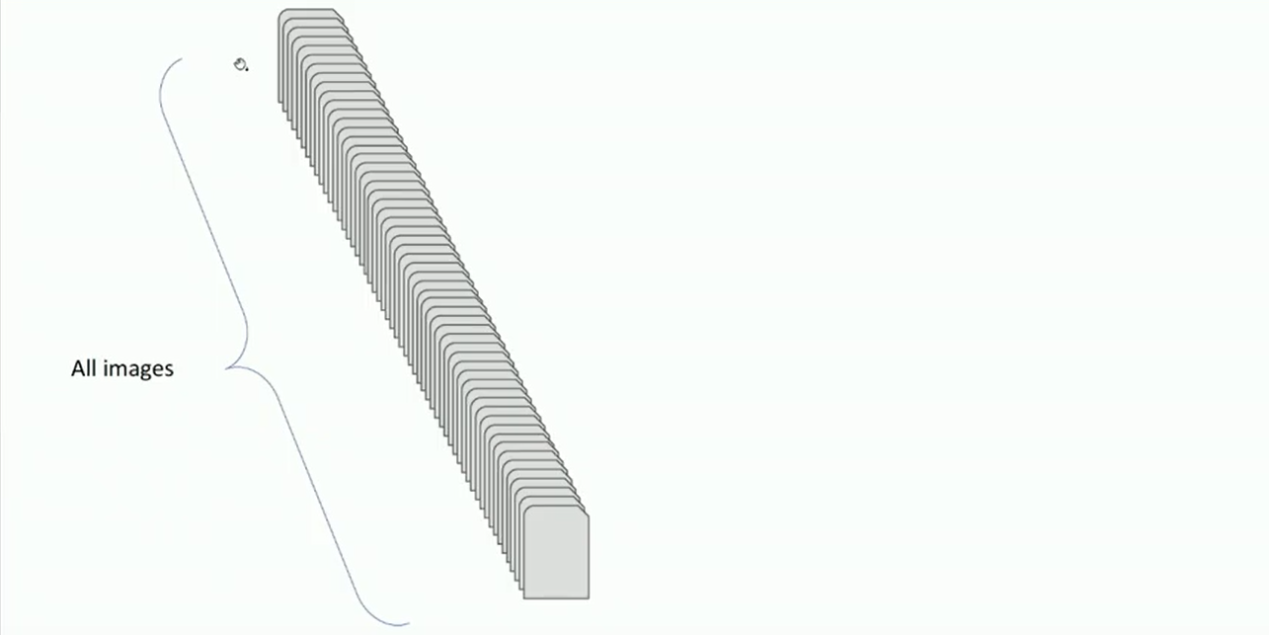
Categorizing images by accuracy

Slide 13
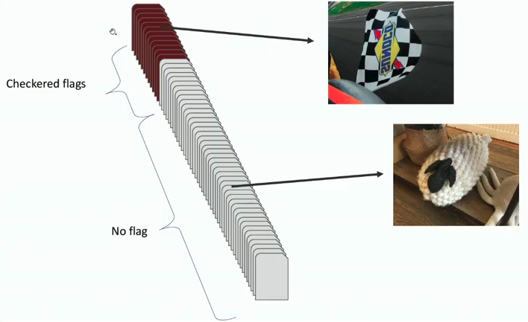
Categorizing images by accuracy

Slide 14
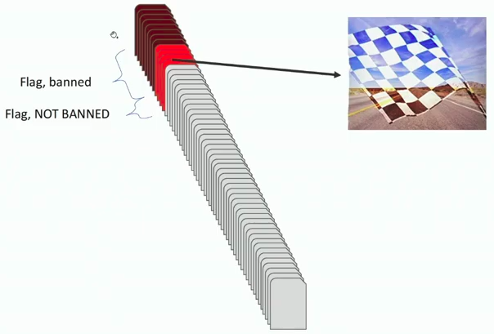
Categorizing images by accuracy

Slide 15
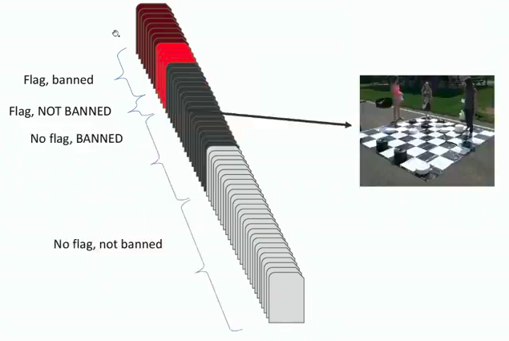
Categorizing images by accuracy

Slide 16
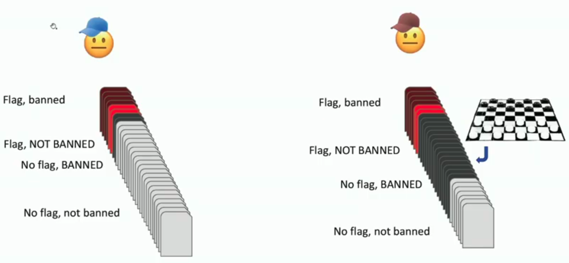
Red Checkerboard images incorrectly banned

Slide 17
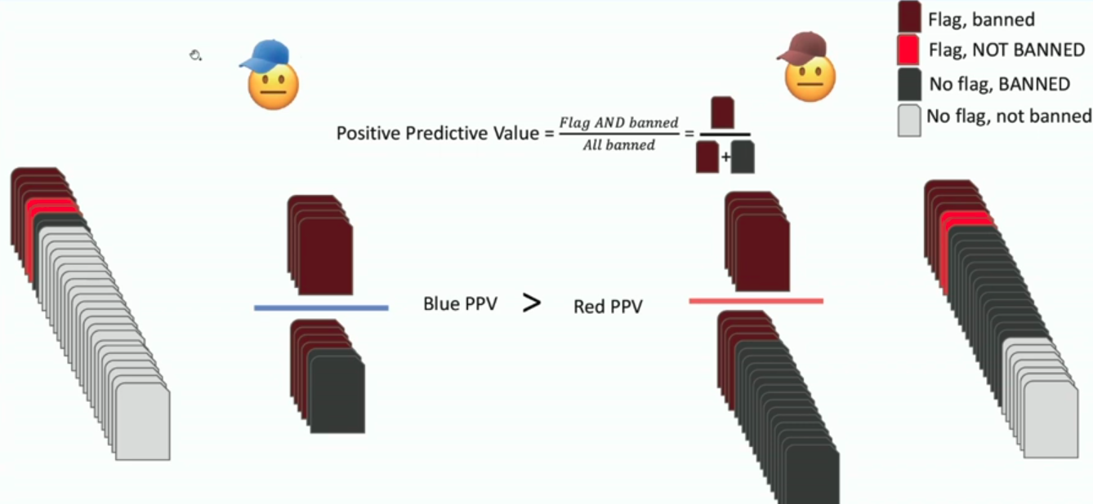
Measuring error imbalance: PPV
Notes:
4 ways to measure the error imbalance.. Blue ppv higher I.e. blue images that were banned were actually cf

Slide 18
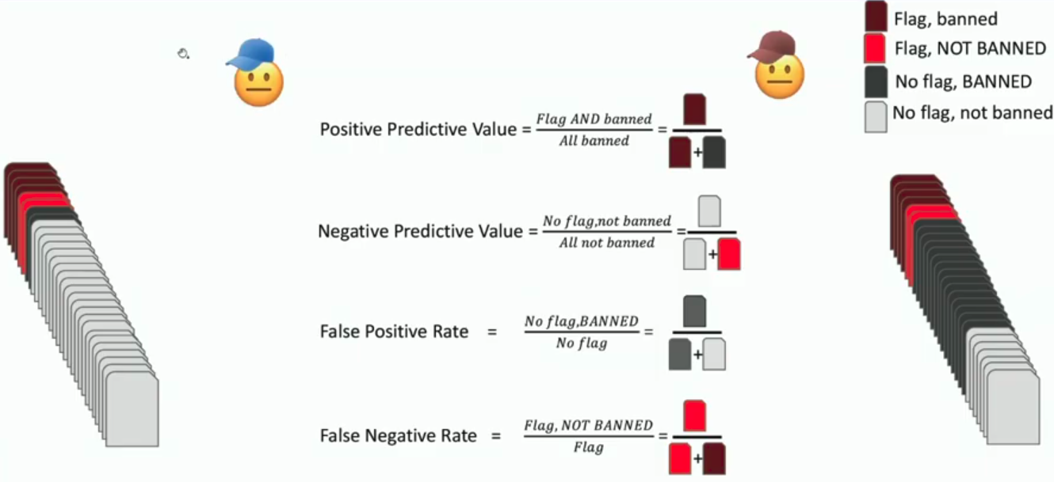
Group Fairness: Measuring/ Correcting error imbalance
Notes:
Usually measuring or equalizing these values between groups is called group fairness
Change of strategy

Slide 19
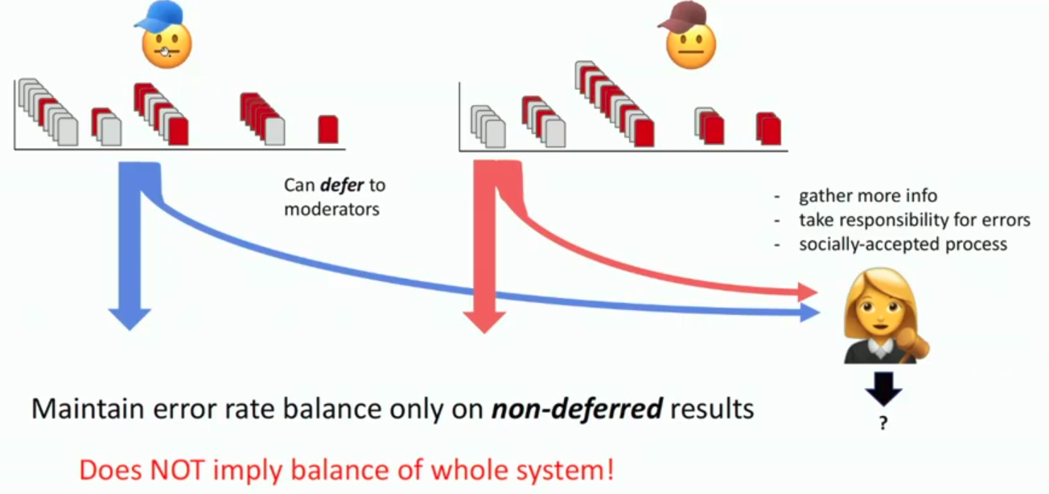
Deferring Classifiers
Discussed by
[Zemel, Madrasi, Pitassi '17]
Notes:
The idea is that rather than making a binary decision on every image that we get, we can defer on some of these images to a downstream decision maker (moderator)
Why would we do this?
1) moderator more accurate but was too expensive or not scalable enough
This avoids a tradeoff with accuracy
We are maintaining error balance only on non deferred results

Slide 20
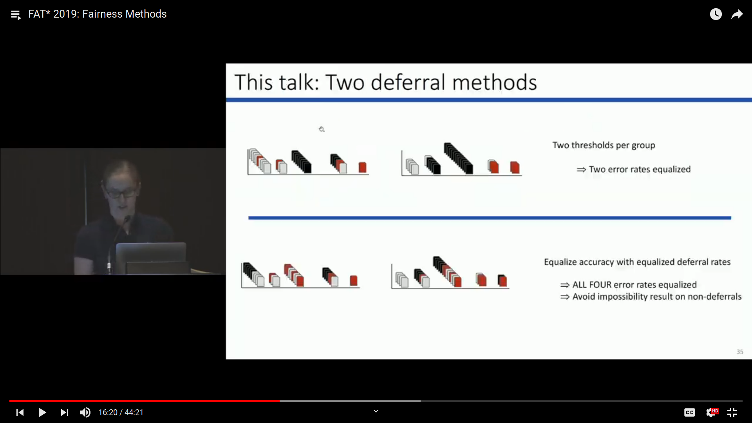
Two deferral methods
Notes:
Deferred on low confidence

Slide 21
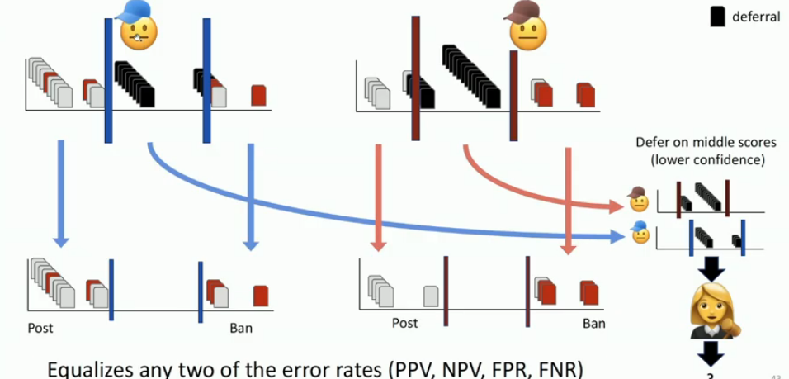
Method 1: 2 Thresholds per group

Slide 22
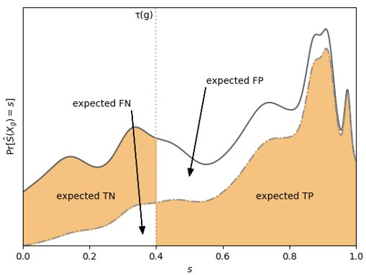
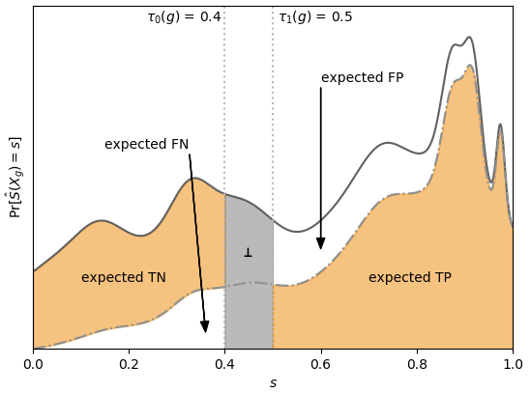

Slide 23
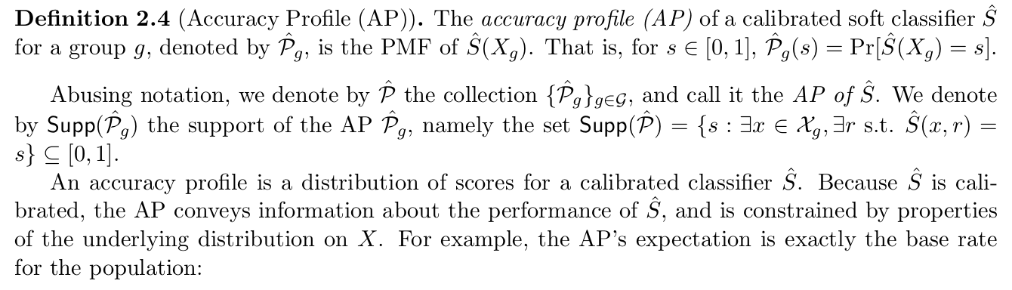
Algorithm
Preliminaries: Calibration, AP,
Notes:
Calibration: Rather than making hard decisions directly, we will first create a soft classifier to generate calibrated score and based on that we will take dicisions.
AP: Typically, we equalizes FPR and FNR for all protected groups BUT here we are equalizing FPR, FNR, PPV and NPV based on soft classifiers score for each group

Slide 24
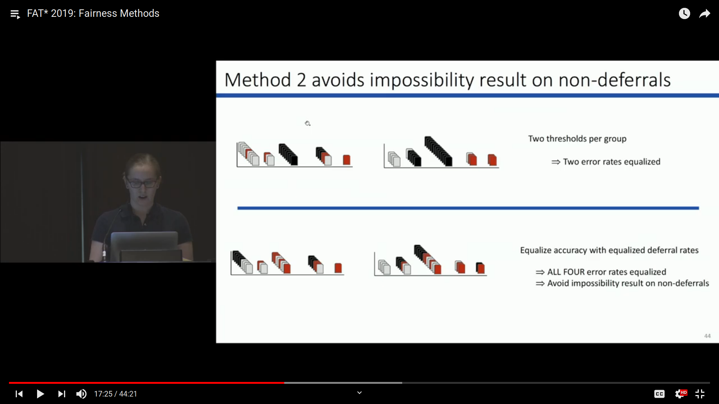
Method 2 avoids impossibility result on non-deferrals

Slide 25
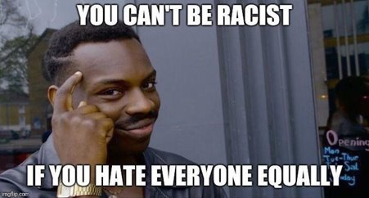
Equalize accuracy profile with equal deferral rate
Notes:
POST-PROCESSING technique to equalize PPV, NPV, FNR and FPR.

Slide 26
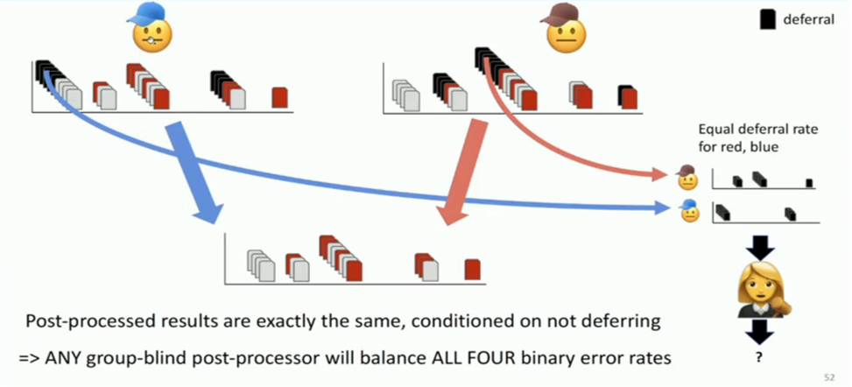
Equalize accuracy with equal deferral rate
Notes:
Equalizing the AP makes the post processor group-blind.

Slide 27
Experiment 1: COMPAS
Scores between 1 and 10 given to individuals
Scores for African-Americans more evenly distributed as opposed to the skewed distribution of Caucasians
Thresholding with deferrals
Converting one AP into another
Equalizing APs

Slide 28
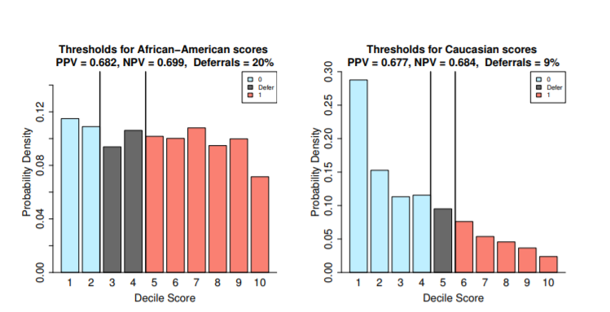
Thresholds

Slide 29
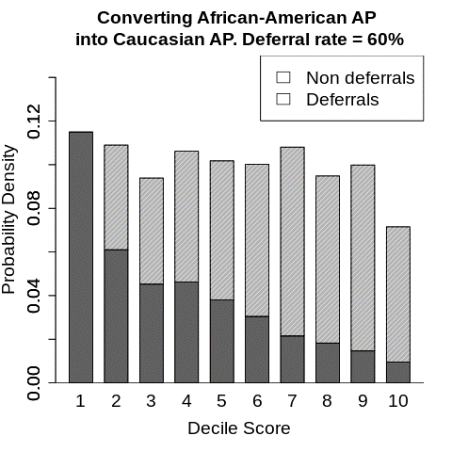
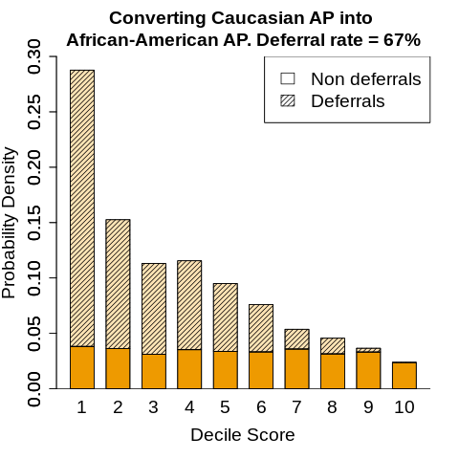
Converting one AP into another (Race)
Notes:
This conversion is calculated by dividing PDF of both the groups\

Slide 30
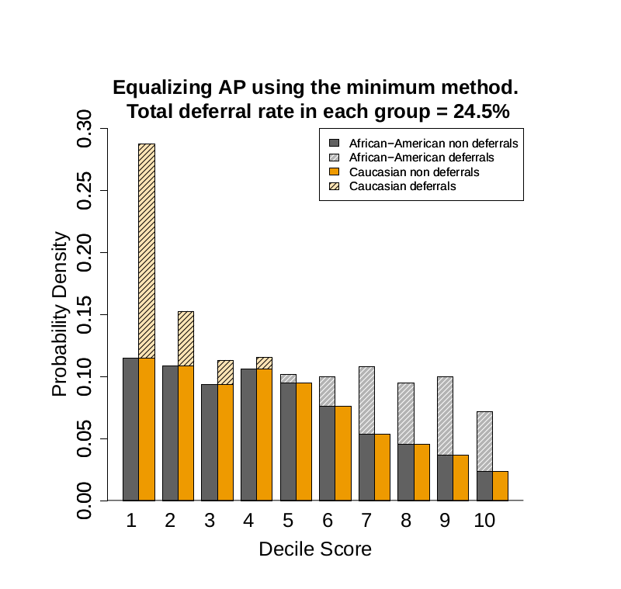
Equalizing APs
Notes:
African american deferrals are high risk and caucasian are low risk

Slide 31
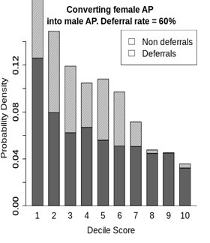
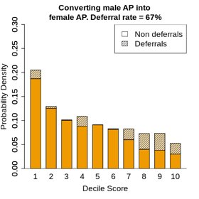
Converting one AP into another (Gender)

Slide 32
Observations
Method of deferring: (race)
Only on African-Americans – 36%
Only on Caucasians – 25%
Equal fraction of African Americans and Caucasians – 25%

Slide 33
Experiment 3: Health Care domain
Imagine there was a simple test to see whether you were developing Alzheimer’s disease. You would look at a picture and describe it, software would assess the way you spoke, and based on your answer, tell you whether you had early-stage Alzheimer’s. It would be quick, easy, and over 90% accurate—except for you, it doesn’t work.
That might be because you’re from Africa. Or because you’re from India, or China, or Michigan. Imagine most of the world is getting healthier because of some new technology, but you’re getting left behind.

Slide 34
Experiment 4: Image dataset
Image dataset
Multiclass

Slide 35
Summary
This is a very exciting, interesting field.
The context may also affect the way one defines the deferral analogues of FPR and FNR.
The first approach we considered is to condition on not deferring.
A second approach is to leave the original definition unchanged.
The unconditional FPR effectively categorizes deferrals as correct output.
Those who work with AI should be ready!!

Slide 36
Recommendations
ML is domain-specific: We need to understand the legal & social context.
Besides inspecting models, Scrutinize data and How it was generated.
Besides static one-shot problems, study long-term effects, feedback loops, and interventions.
Establish qualitative understanding of When/Why ML is the right tool for the application.
Establish understanding of What Constitutes Negligence?

Slide 37
References
Ran canetti, Aloni Cohen, Nishanth Dikkala, Govind Ramnarayan, Sarah Scheffer, Adam Smith 2019. From soft classifiers to hard decisions. https://arxiv.org/pdf/1810.02003.pdf
http://www.cs.toronto.edu/~madras/presentations/fairness-ml-uaig.pdf
https://fatconference.org/2019/acceptedpapers.html
https://fairmlclass.github.io/
https://www.youtube.com/watch?v=Ecl60vmMD5o&t=1222s
http://www.cis.upenn.edu/~aaroth/

